Slide 1


Members:
González Hernández Cruz Omar
Cruz Arredondo José David
Pulido Larios Cristopher
Salas Figueroa Jesús Nahataen

Slide 2



What is Node.js?
Node.js is an open-source, cross-platform JavaScript runtime environment that allows developers to build server-side and networking applications. It is built on the V8 JavaScript engine, which is developed by Google for the Chrome web browser. Node.js enables developers to use JavaScript for both client-side and server-side scripting, which streamlines the development process by allowing the use of a single programming language throughout the application stack.

Slide 3
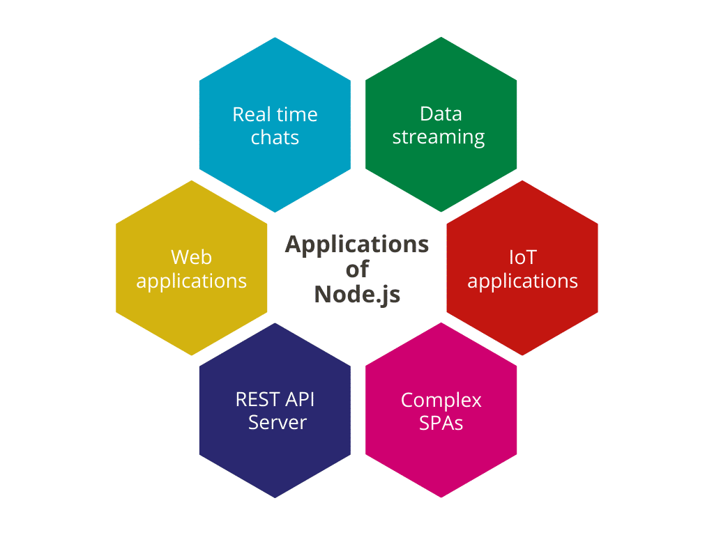
Characteristics
Node.js is used for building server-side and networking applications. It allows developers to use JavaScript for both client-side and server-side scripting, enabling a unified language across the application stack.

Slide 4
Advanteges
1. Performance and scalability
Node.js takes advantage of Google's V8 engine to compile and execute JavaScript code at high speed from your web application. As a single-threaded programming language, Node.js uses an event model that allows it to handle multiple simultaneous connections without blocking the main process.
2. Ease of learning
Since JavaScript is a very popular language in web development, programmers who are already proficient in it can quickly adapt to Node.js.
3. Package ecosystem and community
Node.js has an ecosystem of open-source packages and modules called NPM, which makes it easy to reuse and share code between developers. Additionally, the Node.js community is active and collaborative, which encourages the exchange of knowledge and solutions.

Slide 5
Disadvanteges
1. Asynchronous programming and error handling
The Node.js asynchronous programming model can be difficult to navigate for developers accustomed to synchronous programming. Additionally, error handling in Node.js can be complicated, especially in larger applications.
2. Lack of support for multithreaded programming
Node.js uses a single thread model, which can limit your ability to take full advantage of the capabilities of multi-core hardware on modern servers.
3. Relative maturity and API changes
Although Node.js has gained popularity, it is still a relatively young technology compared to other server languages and platforms. This may result in frequent API changes and missing some mature features and functionality.

Slide 6



Architecture
1. V8 Engine:
Node.js is built on the V8 JavaScript engine, which is developed by Google for use in Chrome. V8 compiles JavaScript code directly to native machine code for efficient execution.
2. Libuv:
Libuv is a multi-platform support library with a focus on asynchronous I/O operations. It provides event loops, file system operations, and other essential functionalities for building asynchronous applications. Node.js uses Libuv to handle asynchronous operations like file I/O, network requests, and timers.
3. NPM (Node Package Manager):
NPM is the package manager for Node.js. It allows developers to easily manage project dependencies, share packages with others, and handle versioning. NPM simplifies the process of integrating third-party libraries into Node.js applications.

Slide 7

Node.JS in action

Slide 8






Node.JS. Is used by:

Slide 9
console.log(“Thanks for you attention");

